Slide 1


Real Time Driver Drowsiness Detection System
Institute of Engineering & Technology
SESSION : 2022 – 23
Team Members :
Ajit Sharma
Vipul Kumar
Sushant Gautam
Anuj Singh
Supervised By :
Dr. Rakesh Kumar
(Institute of Engineering & Technology)

Slide 2

CONTENT
ABSTRACT
INTRODUCTION
- Overview and Motivation
- Objective
- Scope
FUTURE SCOPE
CONCLUSION

Slide 3
ABSTRACT
Road crashes and related accidents are a common cause of injury and death among people. According to 2015 data from the World Health Organization, road accidents have killed at least 1.25 million people worldwide, which means that every 25 seconds a person will have a fatal accident. Although the cost of road accidents in Europe is estimated at 160 billion Euros, sleep drowsiness causes about 100,000 accidents a year in the United States alone as reported by the American National Highway Traffic Safety Administration (NHTSA). In this paper, a new way of finding sleep is actually proposed. This method is based on the in-depth learning method that can be used in Android applications with high accuracy. The main contribution of this work is the pressure of the heavy-duty model on the lightweight model. In addition, the small network structure is designed based on the discovery of an important facial history point to determine if the driver is drowsy. The proposed model is capable of achieving more than 85% accuracy.

Slide 4
INTRODUCTION
1.1 Motivation and Overview
Driving activities require full attention and great brain power. In addition, driving requires good coordination of hand and foot movements, gears moving while looking at other vehicles. Lack of attention can be detrimental to drivers, pedestrians, and economic activities. Therefore, it is important so that the country has strong laws and regulations to maintain the safety of land transport. In addition, the complexity and road features can influence the driver’s attention. For example, in India the current road infrastructure is far beyond the number of vehicles produced and sold is unequal in terms of road infrastructure. About 20% of people admitted that they had ever slept while driving, while 40% of people admitted that this happened at least once in their driving career.

Slide 5
Studies show that, in India, 40% of highway accidents or nearby accidents occur as a result of drowsiness and more than 50% of all fatal road accidents involving more than two vehicles are related to alcohol. More than 65% of all single vehicle accidents are related to alcohol consumption. Looking at these statistics, it is important that we improve the driver security system. In order to develop such a system, we need to measure the condition of the driver.
This is especially true in big cities like Delhi, Mumbai and Chennai. India recorded 3,54,796 cases of road accidents in 2020 in which 1,33,201 people were killed and 3,35,201 were injured, said the NCRB, which works under the Union Home Affairs Department. Government should not always be responsible for controlling vehicle growth and poor infrastructure. In addition to these traffic elements, drivers break traffic rules (speeding, drinking, and traffic light offense) and is a major culprit in car accidents. Even enough road infrastructures and the best people driving, accidents are inevitable.

Slide 6
Authors and their proposed algorithm
[1] As sleep creates chances of accidents and crashes in the world, the researchers proposed different solutions ranging from finding patterns in driving habits to analysing drowsiness of the driver while driving. Most of the solution is predictive, measuring the drowsiness counting alert system through machine learning. The most common proposed method is described below: -
One of the approaches given by the author McDonald et al. he creates a contextual and temporal approaches algorithm that gives steering angles, vehicle speeds and accelerator pedal positions. After that these values are passed into the Bayesian Network if the driver shows signs of drowsiness. The algorithm was found to have lower false values ​​than PERCLOS methods, which predicted drowsiness based on eyelid movements and patterns. The implication of this study is that accurate prediction, context is important. The data that you photograph in the past 10 seconds is important in understanding whether a person is at risk of taking a sleep-related route.

Slide 7
Many authors give solutions to drowsiness through the power of computer vision, means Using Deep Learning. It is tools that provide new tools to computer vision for detection and classification. Computer-related applications use these methods for object acquisition, health and wellness, and agricultural systems. Tayyab Khan proposed a solution to measure the curvature of the eyelid and thus determine whether the eyes were closed or not. They have achieved 95% accuracy in this way, but the limit is that there needs to be enough light for this method to work as it does not work well at night.
The way most companies try to follow is to combine the two different strategies described above and use multiple inputs to reach a drowsiness app decision by combining blinking vision, eye tracking, and critical monitoring Smart glass monitors these features and delivers. drowsy to intervene in a hurry and ask the driver to rest. Integration methods require multiple sensors such as infrared, cameras and heart rate monitors in one location to produce the best results.

Slide 8
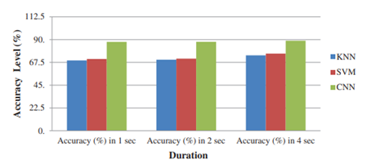
Fig.1 (Comparison of classifier types in terms of accuracy level)

Slide 9
Tanvi Naxane, Sayli Shrungare, Shraddha Bhandarkar, Shivani Rajhance, Mrs. Pranali Deshmukh and Tushar Kute propose a model the primary purpose of his paper was to propose a way to alert sleepy drivers in the act of driving. Most of the traditional methods to detect drowsiness are based on behavioral aspects while some are intrusive and may distract drivers, while some require expensive sensors/hardware. Therefore, in this paper, driver’s drowsiness detection system is developed and implemented to aid drowsy drivers from falling asleep and to prevent accidents.
There model was based on the Behavioural Measures considering a drowsy person displays a number of characteristic facial movements and expressions, including rapid and constant blinking, nodding or swinging their head and frequent yawning. They used Neural Network Algorithms to detect person behavioural.

Slide 10
VGG16 as Transfer Learning:
Due to longer training time durations, they used a shortcut to this is to use/re-use an existing model/pre-trained model and model weights that were developed for standard use.
They used these pre-trained models combined with new model or used directly for carrying out various classification tasks.
Challenges:
Their model was able to successfully incur satisfactory results. However, the main challenge faced was training of images in dim/low light as the model finds it difficult to process images in extremely low light which results in poor feature extraction and feature selection and therefore, wrong/inaccurate predictions.
Another challenge that there model faced was live capturing, processing and training of videos and splitting the captured/acquired video into a series of picture frames for further processing, feature extraction and finally classification.
Conclusion:
In their paper a Driver’s Drowsiness Detection System proposed and using VGG16 model their model achieves
an accuracy of 99.96%.

Slide 11
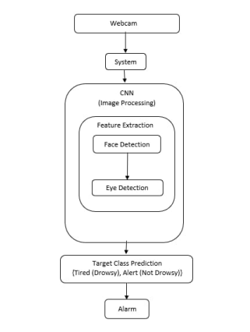
Fig 2 (system working flow graph)

Slide 12
NEURAL NETWORK ALGORITHMS
As we know, a neural network is made up of several interconnected computational units. Within the neural network, a basic computational unit performing specific computation or processing is called a Neuron. Neuron is mainly a node through which data computation is carried out. They receive input signals from any one the layers and it sends out the output signal to the subsequent layers.
Learning Process of Neural Networks - Learning Process of a Neural Network is divided into two phases - Forward Propagation and Back Propagation. Forward Propagation involves propagation or transferring of information from the input layer to the output layer. This whole one cycle of passing data from input layer to output layer is called Forward Propagation. Whereas, the propagation of information from output layer to the input layer is called Back Propagation. The output from the output layer is computed further to calculate the possible loss.

Slide 13
After we quantity or obtain loss/cost/error, our next step is to use an Optimizer. The obtained loss is analyzed and a suitable Optimizer is used to optimize the values of weights (w) and biases (b). Optimizers perform ’Back Propagation’ where the model learns. This whole process is repeated until the model delivers best optimized results.
There are mainly 3 types of layers for Neural Network based Deep Learning models - Input Layer, Hidden Layer and Output layer where the Input Layer is provided with raw input data or external data and the output from the Input Layer is fed to the Hidden Layer for further processing and finally the processed data is then given to the Output Layer which gives us the final output/prediction. Neural Networks consist many hidden layers and they can get vast in structure whereas Shallow Networks tend to have less number of layers which makes them less complex as they require more up-front knowledge of optimal features/characteristics.

Slide 14
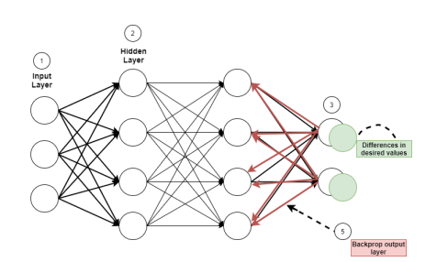
Fig 3 Learning process of neural network
There are several types of neural networks, some of the most commonly used are - Convolutional Neural Networks (CNN), Recurrent Neural Networks (RNN) and Artificial Neural Networks (ANN). For our system it was very essential to understand all the above-mentioned neural networks and get a better understanding of various neural network models

Slide 15
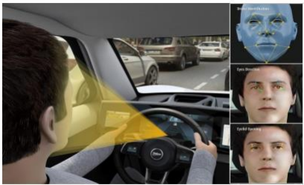
OpenCV
OpenCV is an open-source computer source library available in python encoding to encrypt the visual skills of our smart pc. OpenCV was expected for computational capability and having a high focus on ongoing picture location and distinguishing proof. OpenCV is coded with streamlined C and can take work with multicore processors. If we need progressively programmed improvement utilizing Intel models [Intel]. These comprise of low-level schedules in different algorithmic regions which are streamlined. OpenCV therefore uses the IPP library, at runtime if that library is introduced.
Fig. 4 : This shows how the system would work and look in real world

Slide 16
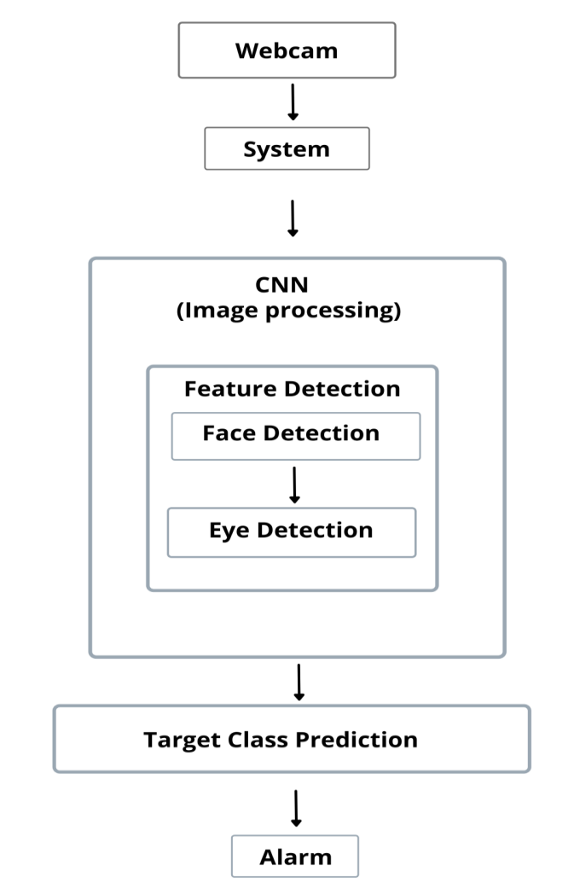
System Architecture:
When the driver is driving, the driver's face is taken by camera and is converted into video streaming. e application then analyzes video to detect drowsiness and fatigue and also checks the level of drowsiness. At this stage, the key areas to consider for analysis are: Driver's face tracking, driver's fatigue status, and recognition of important facial regions based on blindfolds and yawn. Finally, when drowsiness appears, a voice warning is given.

Slide 17
Figure 1 shows the High-Level System Architecture integration input model and pre-processing as well phase testing. Phase 1 involves pre-processing the video human face tracking stream. Phase 2 involves extraction of important facial regions such as eyes and mouth. Stage 3 including the detection of sleep symptoms such as blindness, blinking, and yawning. Detailed Design The system is designed in such a way that the driver's face and mouth are constantly monitored and if the pre-defined alert levels are considered erroneous and dangerous, then the appropriate alarm is turned off and, appropriately, action is taken. to prevent any death. Figure 2 shows the Driver Sleep System Design and Yaw Detection System. It is evident that the camera is used to monitor the driver's face continuously and when it detects drowsiness or fatigue, the system on the dashboard generates a warning type warning to the driver.

Slide 18
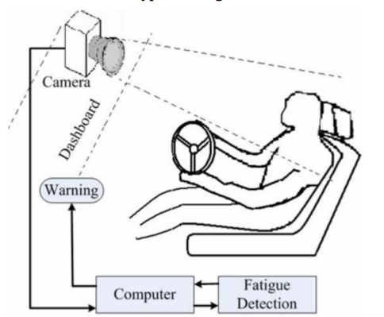
(Fig.4. System Design)

Slide 19
FUTURE SCOPE
This system can be further utilized and employed to alert/notify the driver during the night, which happens to be the prime time for the drivers to feel sleepy or fall asleep. A night vision camera can be employed for this purpose to deliver accurate results.
Furthermore, a video dataset or live videos could be used as input to our model which would further divide the acquired video into a stream of images for further CNN processing and classification into any one of the categories or defined classes, making our model more reliable and dependable. Video Dataset can be created by the programmer or the team members and can be later used for training purposes to provide better optimized results.

Slide 20
CONCLUSION
The model can detect drowsiness by monitoring the eyes and mouth. Shape predictors are used to determine important facial features. The inputs provided in these methods are the landmarks of the face found in obtaining the history of the face. All of this work is designed to reduce the risk of accidents and the participation of technology in order to prevent deaths from road accidents. Future work on this paper may focus on the use of external factors to measure fatigue and drowsiness. [18] External factors may be weather conditions, vehicle conditions, sleep time and equipment data. Drowsiness of drivers is one of the main threats to road safety, and for commercial motorists, the problem is even greater. Factors contributing to this critical security crisis are 24-hour services, unforeseen environmental conditions, annual mileage, and increased workloads. One of the most important preventive measures needed to resolve this problem is to regularly monitor the driver's sleep status and provide information on their driver's status so that they can take necessary action. Currently, no adjustment can be made to zoom or camera direction during system operation. In the future, more work during the operation of the system. In the future, more work can be done to make eye contact automatically afterwards local.

Slide 21

Thanks!

